Slide 1
Homework4 will be posted on Fri, Oct 31.

Slide 2
Set
A set is an unordered collection of elements, without duplicates
Supports efficient membership tests
Creating a Set in Python
set1 = set({1,2,2,4,4,5})
set2 = {4,5,5,6}
print(set1)
print(set2)
Common set operations:
add()
remove()
union()
intersection()
isdisjoint()
issubset()
issuperset()
…
Output:
{1, 2, 4, 5}
{4,5,6}

Slide 3
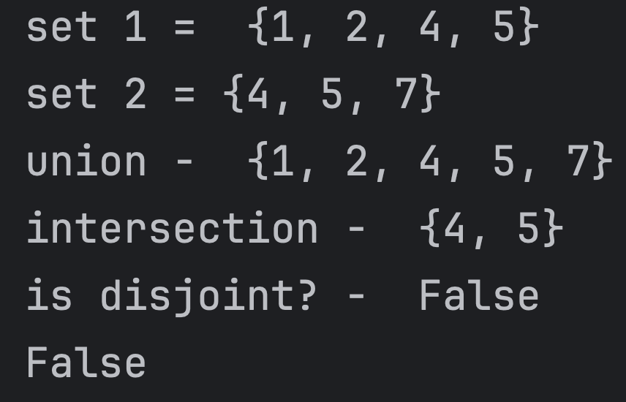
s1 = set({1,2,2,4,4,5}) s2 = {4,5,5,6} s2.add(7) #add new item s2.remove(6) #remove existing item print('set 1 = ',s1) print('set 2 =', s2) print('union - ',s1.union(s2)) print('intersection - ',s1.intersection(s2)) print('is disjoint? - ',s1.isdisjoint(s2))
print(10 in s2) #membership test
#...

Slide 4
Set vs List
List | Set
Ordered | Unordered
May contain duplicates | Each element is unique
Optimized for accessing elements by index and maintaining order | Optimized for membership testing and eliminating duplicates
Time complexity for common list operations:
Inserting an item – O(n)
Removing an item – O(n)
Looking up an item/membership testing – O(n)
Access by index – O(1)
Time complexity for common set operations:
Adding an item – O(1)
Removing an item – O(1)
Looking up an item/membership testing – O(1)
Accessing by index – not supported

Slide 5
Exercise: Using a set to remove duplicates from the list

Slide 6
Graphical User Interfaces – Part1
in Python
Introduction to Computing Using Python

Slide 7
Graphical User Interfaces
Graphical User Interface (GUI) – interacting with your application
Gives you a better overview of what an application does
It makes it easier to use the application
A developer typically uses a GUI API (application programming interface)
Python’s standard library provides such an API - tkinter

Slide 8
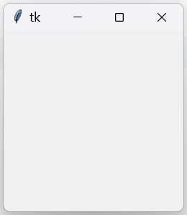


Basics of tkinter GUI development
GUI consists of basic building blocks
Buttons, labels, text entry forms, menus, check boxes, scroll bar etc.
The building blocks are commonly referred to as widgets
A Tk object is a GUI widget that represents the GUI window
After executing the code above, a blank window will be created
A tkinter GUI window

Slide 9

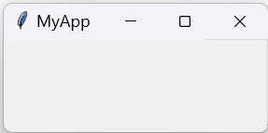
Setting the Tk window title

Slide 10
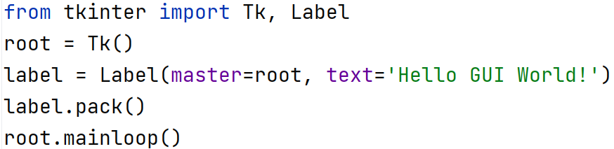
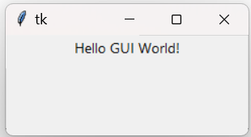
Widget Label for Displaying Text
Import Label
Create label: Label(master, text)
pack() – places the widget inside the master

Slide 11
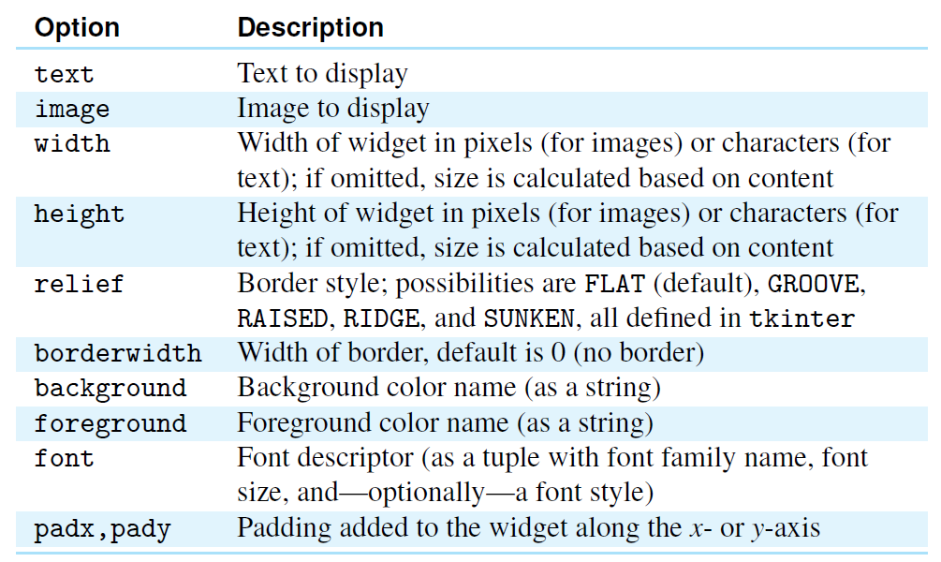
Tkinter widget optoins

Slide 12

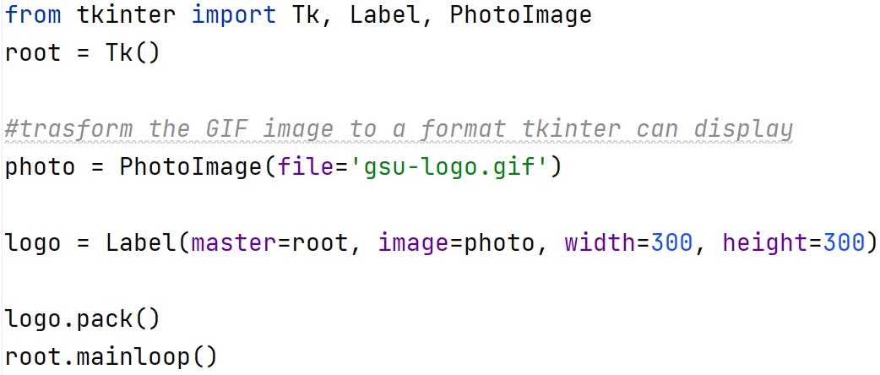
Displaying images

Slide 13
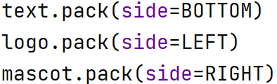
Packing Widgets
Tkinter geometry manager – responsible for placement of widgets
The pack() method can be used to provide directives to the geometry manager
Example:

Slide 14
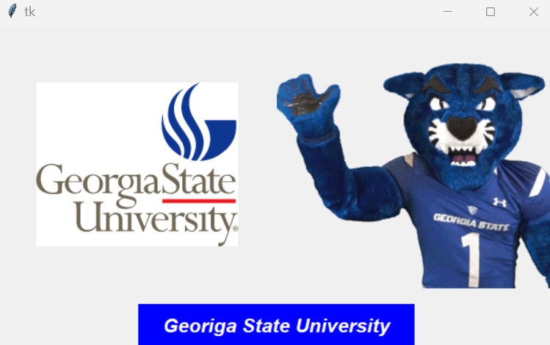
from tkinter import Tk, Label, PhotoImage, BOTTOM, LEFT, RIGHT root = Tk() #trasform the GIF image to a format tkinter can display photo1 = PhotoImage(file='gsu-logo.gif') photo2 = PhotoImage(file='mascot.gif') logo = Label(master=root, image=photo1, width=300, height=300) mascot = Label(master=root, image=photo2, width=300, height=300) text = Label(root, font=('Helvetica', 16, 'bold italic'), foreground='white', background='blue', padx = 25, pady = 10, text= 'Georiga State University') text.pack(side=BOTTOM) logo.pack(side=LEFT) mascot.pack(side=RIGHT) root.mainloop()

Slide 15
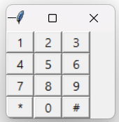
Arranging Widgets in a Grid
grid(row, column)
from tkinter import Tk, Label, RAISED root = Tk() labels = [['1', '2', '3'], # phone dial label texts ['4', '5', '6'], # organized in a grid ['7', '8', '9'], ['*', '0', '#']] for r in range(4): # for every row r = 0, 1, 2, 3 for c in range(3): # for every column c = 0, 1, 2 # create label for row r and column c label = Label(root, relief=RAISED, # raised border padx=10, # make label wide text=labels[r][c]) # label text # place label in row r and column c label.grid(row=r, column=c) root.mainloop()

Slide 16
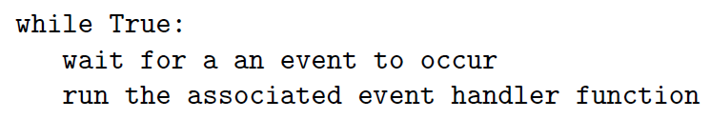
Event-based tkinter widgets
mainloop()

Slide 17
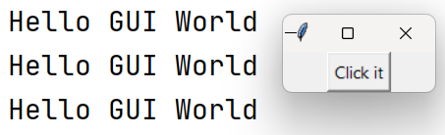
Event-based tkinter widgets : Button
from tkinter import Tk, Button def clicked(): # event handler for the button print("Hello GUI World") root = Tk() # create button labeled 'Click it' and event handler clicked() button = Button(root, text='Click it', # text on top of button command=clicked) # button click event handler button.pack() root.mainloop()
clicked() is said to be an event handler

Slide 18

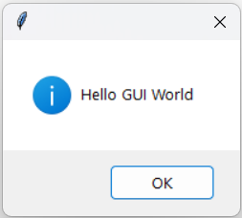
A new window pops up and shows the message

Slide 19
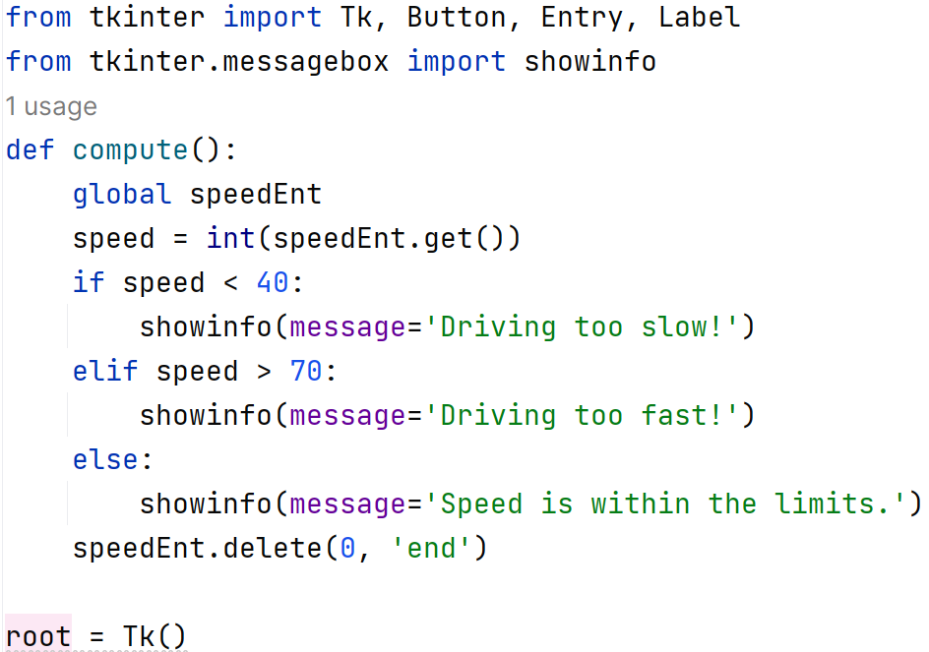
Event-based tkinter widgets : Entry

Slide 20
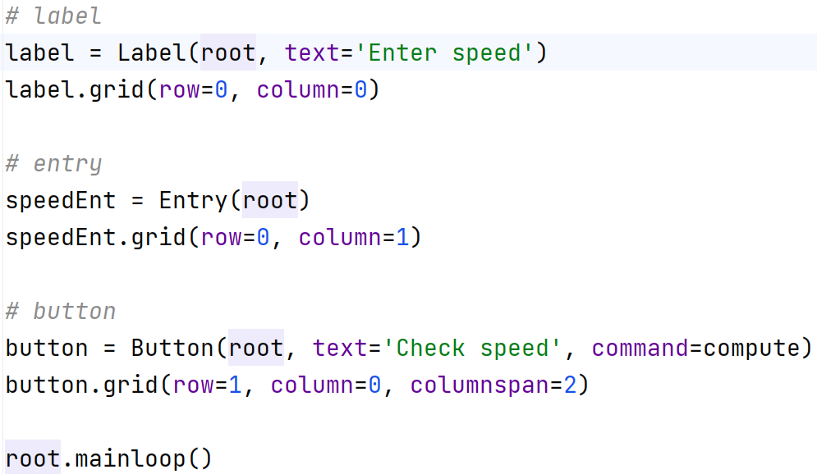
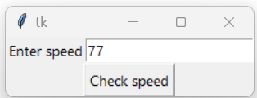
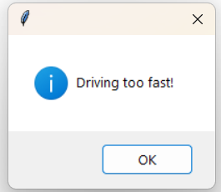
Event-based tkinter widgets : Entry (cont.)

Slide 21
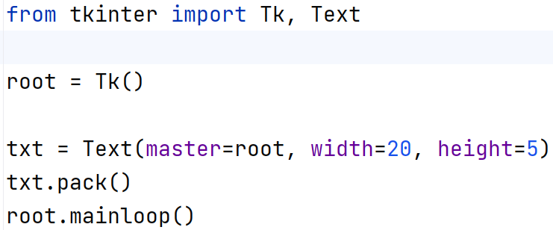
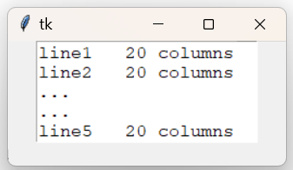
Text Widget
Used to interactively enter multiple lines of text

Slide 22
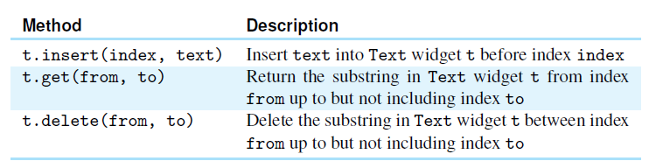
Text Widget (cont.)

Slide 23
Text Widget (cont.)
#Insert text txt.insert(END, 'First Line\n') txt.insert(END, 'Second Line\n') #Get text print('Contents of the Text widget:\n', txt.get('1.0',END)) #Delete text - delete the first line txt.delete(1.0,2.0) #Delete text - delete first three characters txt.delete(1.0,1.3) #Delete entire text content txt.delete(1.0, END)

Slide 24
Attendance

